Slide 1
Microsoft Azure Readiness: Starter Kits for Partners

Slide 2
Agenda
Microsoft Cloud Value Proposition
Partner Challenges
Starter Kits Introduction
Starter Kits Deep Dive
Notes:
Based on the Modality (1:Many or 1:1) inform Partners how long the presentation is going to take.
Microsoft Cloud Value Proposition
Partner Challenges
Starter Kits Introduction
Starter Kits Deep Dive

Slide 3

The Audience…
Please introduce yourself:
Name
Role
Organization
Expectations
Notes:
Understand your audience and expectations.

Slide 4
Whiteboard: What is the value of Cloud Computing and how to position it?
What values does Cloud Computing bring to Customers?
What values does Cloud Computing bring to Partners?
How do I get ready to deliver Cloud Engagements?
How do I get ready to sell and deploy Microsoft Azure Solutions?
Notes:
Notes:
This is a great moment to understand your Audience, and ask if they understand the value of Cloud and how to position it.
Based on the Answers, you may present the following slides to review the basic concepts of Cloud Computing and the benefits it provides.

Slide 5
Cloud and Microsoft Azure
Notes:
At this moment it should be clear What is Azure and Cloud, but let´s review.

Slide 6


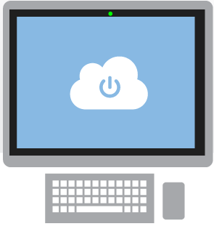


What is the cloud?
What is Cloud Computing?
An approach to computing that’s about internet scale and connecting to a variety of devices and endpoints.
Notes:
Slide Objectives:
Explain how Microsoft thinks of the cloud
Speaking Points:
There are numerous terms and definitions floating around in the industry for “the cloud”, “cloud computing”, “cloud services”, etc.
Microsoft thinks of the cloud as simply an approach to computing that enables applications to be delivered at scale for a variety of workloads and client devices.
The cloud can help deliver IT as a standardized service…freeing you up to focus on your business

Slide 7



Cloud Computing
Characteristics
IT - Flexible and Dynamic
elasticity
self service
Paid by usage
Expense your costs
Notes:
Notes:
Cloud Computing represent your have IT - Flexible and Dynamic.
Treat your IT as a Service.
Some of the benefits will be:
Elasticity
self service

Slide 8
Benefits for the Business
Cloud Computing
Costs more efficient
Focus on the core business
Higher agility
Notes:
What values does Cloud Computing represent for the Business?
Manage Costs more efficient
Allows your company to focus on the core business
Higher agility

Slide 9
Cloud Services Models
Packaged Software
Infrastructure
(as a Service)
Platform
(as a Service)
Software
(as a Service)
Applications
You manage
Applications
Applications
Applications
Data
You manage
Data
Data
Data
Runtime
Runtime
Runtime
Runtime
Managed by vendor
You manage
Middleware
Middleware
Middleware
Middleware
O/S
Managed by vendor
O/S
O/S
O/S
Virtualization
Virtualization
Managed by vendor
Virtualization
Virtualization
Servers
Servers
Servers
Servers
Storage
Storage
Storage
Storage
Networking
Networking
Networking
Networking
Notes:
// Overview for TDM (Briefly features introduction)
Slide Objectives:
Explain the differences and relationship between IaaS, PaaS, and SaaS in more detail.
Speaking Points:
Here’s another way to look at the cloud services taxonomy and how this taxonomy maps to the components in an IT infrastructure.
Packaged Software
With packaged software a customer would be responsible for managing the entire stack – ranging from the network connectivity to the applications.
IaaS
With Infrastructure as a Service, the lower levels of the stack are managed by a vendor. Some of these components can be provided by traditional hosters – in fact most of them have moved to having a virtualized offering.
Very few actually provide an OS
The customer is still responsible for managing the OS through the Applications.
For the developer, an obvious benefit with IaaS is that it frees the developer from many concerns when provisioning physical or virtual machines.
This was one of the earliest and primary use cases for Amazon Web Services Elastic Cloud Compute (EC2).
Developers were able to readily provision virtual machines (AMIs) on EC2, develop and test solutions and, often, run the results ‘in production’.
The only requirement was a credit card to pay for the services.
PaaS
With Platform as a Service, everything from the network connectivity through the runtime is provided and managed by the platform vendor.
The Azure Platform best fits in this category today.
In fact because we don’t provide access to the underlying virtualization or operating system today, we’re often referred to as not providing IaaS.
PaaS offerings further reduce the developer burden by additionally supporting the platform runtime and related application services.
With PaaS, the developer can, almost immediately, begin creating the business logic for an application.
Potentially, the increases in productivity are considerable and, because the hardware and operational aspects of the cloud platform are also managed by the cloud platform provider, applications can quickly be taken from an idea to reality very quickly.
SaaS
Finally, with SaaS, a vendor provides the application and abstracts you from all of the underlying components.

Slide 10
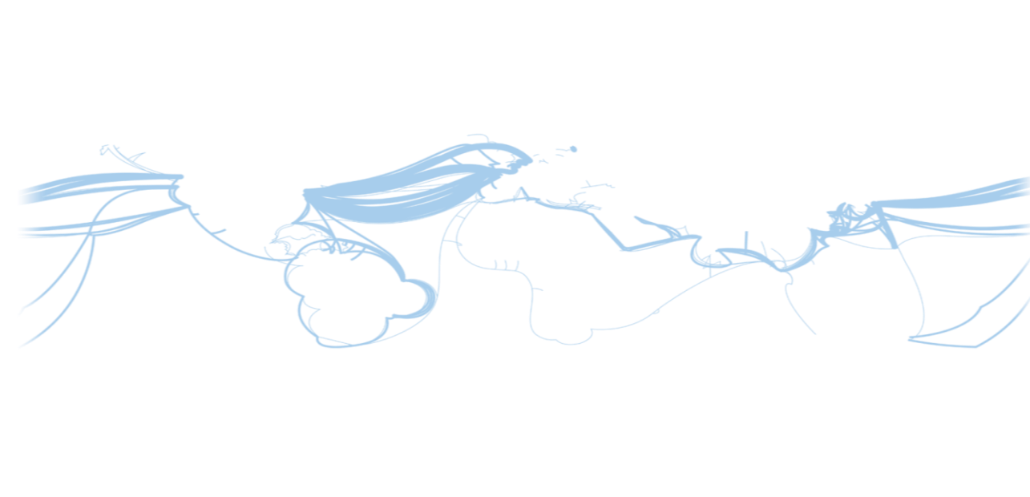
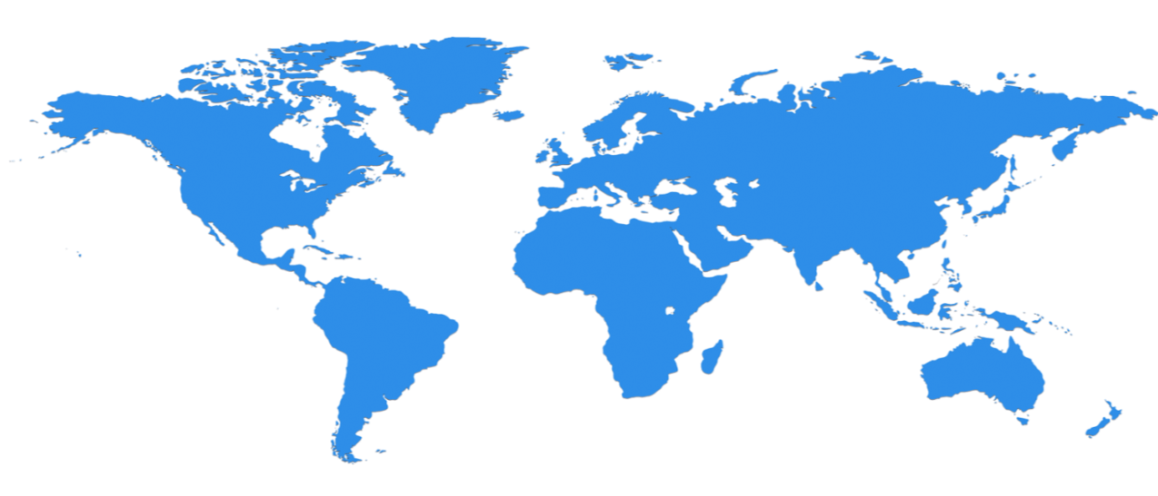

Microsoft Azure: huge infrastructure scale is the enabler
19 Regions ONLINE…huge datacenter capacity around the world…and we’re growing
North Europe
Ireland
West Europe
Netherlands
Central US
Iowa
North Central US
Illinois
US Gov
Iowa
China North *
Beijing
East US
Virginia
Japan East
Saitama
West US
California
China South *
Shanghai
East US 2
Virginia
Japan West
Osaka
India West
TBD
India East
TBD
South Central US
Texas
US Gov
Virginia
East Asia
Hong Kong
SE Asia
Singapore
Australia East
Sydney
Brazil South
Sao Paulo
100+ datacenters
One of the top 3 networks in the world (coverage, speed, connections)
2 x AWS and 6x Google number of offered regions
G Series – Largest VM available in the market – 32 cores, 448GB Ram, SSD…
Australia West
Melbourne
Operational
Announced
* Operated by 21Vianet
Notes:
Over the last few years we’ve truly delivered a huge infrastructure to enable us to grow our services at scale around the globe. Whether it’s our flagship facilities in Quincy, Washington or Boydton, Virginia, or some of the newly announced facilities in Shanghai, Australia and Brazil, it really is key for us to make smart investments around the world to deliver services in a resilient and reliable fashion.
A lot of people ask, what goes into site selection at Microsoft and how do we decide where to place our datacenter investments? There are over thirty-five factors in our site selection criteria. But really, the top elements are around proximity to customers and energy and fiber infrastructure, insuring that we have the capacity and the growth platforms to be able to grow our services.
Another key element is about skilled workforce. We need to insure that we have the right people to run and operate our datacenters on a day to day basis.

Slide 11
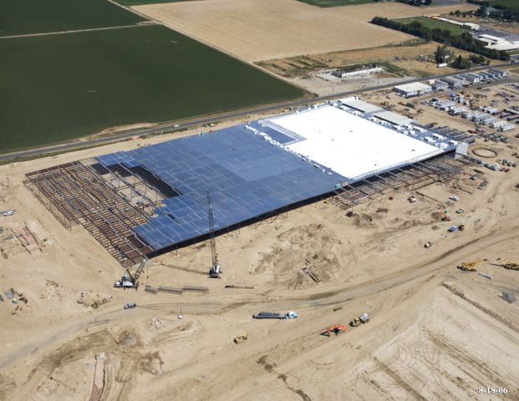
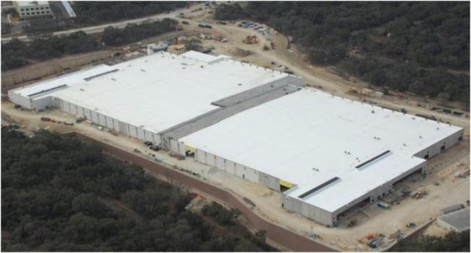
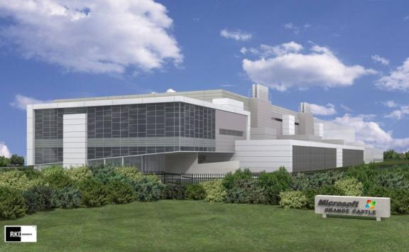

Notes:
Microsoft Azure is Microsoft Public Cloud offering, where we offer IaaS and PaaS services.
It is delivered by state-of-the-at Datacenters spread across the World.

Slide 12

social web - sharepoint
Notes:
Microsoft Azure is Microsoft Public Cloud offering, where we offer IaaS and PaaS services.
It is delivered by state-of-the-at Datacenters spread across the World.

Slide 13
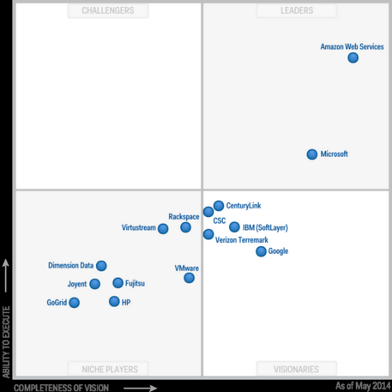
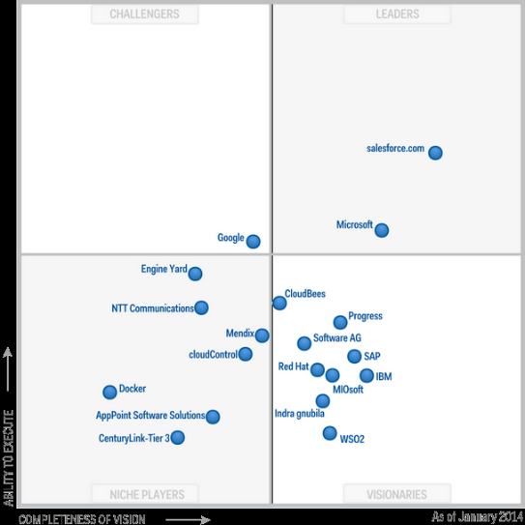
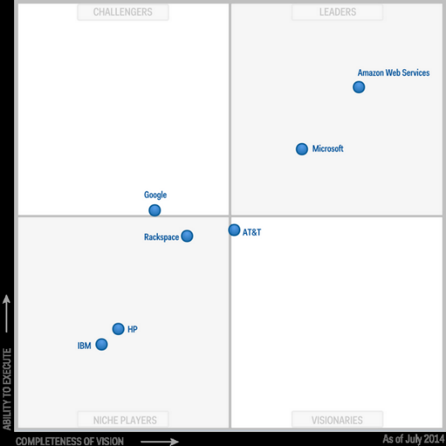
Public Cloud Market Landscape
Microsoft
IaaS
PaaS
Storage
Reference: David Chappell, Microsoft Ignite 2015 | TechEd 2014
Notes:
Notes:
Summarizing the Public Cloud with the Gartner Magic Quadrant
Tell Partner this is Magic Quadrant for Public Cloud.
Highlight Microsoft is also one of the Market Leader
Botton line: Microsoft is the only Leader is all segment of Public, Hybrid and Private Cloud
More details at: https://channel9.msdn.com/Events/Ignite/2015/BRK1455

Slide 14
Public Cloud Platforms
Compute
Data
Others
Machine
Learning
Mobile Services
IaaS
PaaS
Blobs
Relational
NoSQL
Identity
Microsoft
Azure
Virtual Machines
App Service, Cloud Services
Blobs
SQL Database
DocumentDB, Tables
Azure Active Directory
Azure ML
Mobiles Services
Amazon
Web Services
Elastic Compute Cloud (EC2)
Elastic Beanstalk
Simple Storage Service (S3)
Relational Database Service (RDS)
DynamoDB
Amazon ML
Mobiles Services
Google
Cloud Platform
Compute Engine
App Engine
Cloud Storage
Cloud SQL
Cloud Datastore
Prediction API
Mobile Back end Starter
Compute
Object Storage
Database
OpenStack
Salesforce.com Force.com
Force.com App Logic
Force.com Database
Salesforce Identity
Reference: David Chappell, Microsoft Ignite 2015 | TechEd 2014
Notes:
Notes:
Don’t spend time on each vendor, the purpose of this slide is to provide the big picture.
Highlight there are many other services in Azure, we are emphasizing the most important ones.
Botton line: Microsoft Azure is the most complete in Public cloud
More details at: https://channel9.msdn.com/Events/Ignite/2015/BRK1455

Slide 15
Cloud OS - Microsoft’s vision of the unified platform for modern business
Cloud OS
Microsoft’s vision of the unified platform for modern business
Enterprise-grade
Hybrid design
People-focused
Enterprise-grade
Hybrid design
People-focused
Global reach, scale & security to meet business demands
One consistent platform across multiple environments & clouds
Expand tech skillset to the cloud for new innovation
Notes:
Key goal of slide: Land 3 cross-conversation value points of Cloud OS vision/Microsoft approach
Slide talk track:
Enterprise-grade
We understand your existing IT systems and challenges better than any technology company out there.
IDC predicts that 70% of CIOs will embrace a cloud-first strategy in 2016. To get there, organizations need to move at their own pace over a number of years, with many living in a hybrid environment for quite some time. That flexibility – to live in both worlds – even with a cloud-first strategy – is non-negotiable. (Source: IDC CIO Agenda webinar).
So, we aren’t going to tell you to move everything to the cloud. We’ll help you take what you have, upgrade through our Cloud OS strategy and take the journey with you.
Some vendors are making this transition more confusing by calling feature-limited apps “cloud-ready” or force you to use different sign-ons for every online experience or won’t even guarantee continuous availability. Cloud shouldn’t mean lowering your expectations or making compromises.
Microsoft believes you shouldn’t expect any less from the cloud – you should expect more.
It MUST be an enterprise-grade platform
Hybrid Design
By design, our hybrid cloud builds commonalities into the platform, unifying resources across premises to let data and apps flow freely.
Hybrid is the core of Microsoft’s Cloud OS vision. We’re uniquely able to take a hybrid cloud approach to deliver unified compute, storage and networking across a customer’s datacenters, the public cloud and hosted clouds – creating a single application, data and device management platform.
You benefit from a common and consistent approach to development, management, identity, virtualization and data – spanning on-premises to cloud – your cloud, a service provider cloud and Microsoft’s cloud
This gives you the ability, from a one view, to manage apps and data beyond your own private cloud – to a partner cloud – to a public cloud – in a consistent way.
Helps you be very flexible in thinking about how you deploy your apps across the multitude of cloud environments
People-focused
Our people-focused approach means IT professionals, developers and users can leverage existing skills in this new hybrid world.
For years, Microsoft has been delivering experiences that appeal to end-users driving maximum productivity, regardless of location or device.
Microsoft brings that same focus on people to IT and developers – mirroring the familiarity and ease-of-use from our on-premises products into our Cloud services.
The unifying technologies in the Cloud OS enable the flow, management and governance of data and apps across premises and devices to keep employees productive and connected, wherever they are (IT professionals, developers and users).
This all leads to higher satisfaction – from employees to IT – and improved productivity with lower training costs.
With such a large solution and developer footprint – adoption by our enterprise customers speaks for itself – and is also a huge driver of our focus on people and their experiences
Objetivo : Três pontos chaves de Cloud OS visão / abordagem da Microsoft
Plataforma De nível empresarial
Entendemos seus sistemas atuais de TI e os desafios melhor do que qualquer empresa de tecnologia no mercado.
A IDC prevê que 70% dos CIOs vão adotar uma estratégia de nuvem pela primeira vez em 2016. Para chegar lá , as organizações precisam mover-se em seu próprio ritmo ao longo de vários anos , com muitos vivendo em um ambiente híbrido por algum tempo . Essa flexibilidade - de viver em dois mundos (cenario hibrido_ não é negociável . (Fonte: IDC CIO Agenda webinar) .
Então , nós não estamos indo para dizer-lhe para mover tudo para a nuvem. Nós vamos ajudá-lo a tomar o que você tem , atualização através da nossa estratégia de nuvem OS e fazer a viagem com você.
Alguns vendedores estão fazendo essa transição mais confuso chamando aplicações limitadas em recursos " cloud - ready" ou forçá-lo a usar diferentes autenticação para cada experiência on-line ou não vai mesmo garantir a disponibilidade contínua. Nuvem não deve significar redução de suas expectativas ou fazer compromissos .
A Microsoft acredita que você não deve esperar menos a partir da nuvem - você deve esperar mais.
Deve ser uma plataforma de nível empresarial
Solução híbrida
Híbrido é o núcleo da visão de Microsoft Cloud OS. Nós somos o único capaz de ter uma abordagem de nuvem híbrida para entregar computação unificada , armazenamento e redes em toda datacenters de um cliente , a nuvem pública e nuvem hospedados - a criação de uma única aplicação, dados e plataforma de gerenciamento de dispositivos.
Você se beneficia de uma abordagem comum e coerente para o desenvolvimento , gerenciamento de identidade, virtualização e dados - abrangendo no local para a nuvem - sua nuvem , um provedor de nuvem e serviços de nuvem da Microsoft
Isso lhe dá a capacidade , a partir de um único ponto de vista, para gerenciar aplicativos e dados além de sua própria nuvem privada - a uma nuvem parceiro - para uma nuvem pública - de uma forma consistente.
Ajuda você a ser muito flexível em pensar sobre como você implantar seus aplicativos através da multiplicidade de ambientes de nuvem
Pessoas como foco
Nossa abordagem centrada nas pessoas significa que os profissionais de TI , desenvolvedores e usuários podem alavancar conhecimentos existentes neste novo mundo híbrido.
Durante anos, a Microsoft tem vindo a proporcionar experiências que apelam a condução máxima produtividade dos usuarios finais , independentemente do local ou do dispositivo
Microsoft traz esse mesmo foco em pessoas para TI e desenvolvedores - espelhando a familiaridade e facilidade de uso de nossos produtos no local em nossos serviços em nuvem.
As tecnologias unificadas no Cloud OS permitem fluxo , gestão e governança de dados e aplicativos através de instalações e dispositivos para manter os funcionários produtivos e conectados , onde quer que estejam (profissionais de TI, desenvolvedores e usuários ) .
======
De nivel empresarial
Entendemos sus sistemas y desafíos mejor que cualquier compañía de tecnología
IDC predice que el 70 % de los CIOs abarcará una estrategia en la nube por primera vez en 2016 . Para llegar allí, las organizaciones tienen que moverse a su propio ritmo durante varios años , con muchas personas que viven en un entorno híbrido desde hace bastante tiempo . Esa flexibilidad - para vivir en ambos mundos - incluso con una estrategia en la nube primero - no es negociable . (Fuente : IDC CIO webinar del programa) .
Por lo tanto, no vamos a decirle a mover todo a la nube. Le ayudaremos a tomar lo que tienes, y actualizar a través de nuestra estrategia de Cloud OS.
Algunos vendedores están haciendo esta transición más confuso llamando aplicaciones limitadas llamadas “Cloud Ready” o te obligan a utilizar diferentes inicios de sesión para todas las experiencias en línea o incluso no garantiza la disponibilidad continua. La Nube no debe significar la reducción de sus expectativas o hacer compromisos . TIENE que ser una plataforma de nivel empresarial
Diseño híbrido
Por diseño, nuestra nube híbrida se basa en la unificación de los recursos locales para dejar los datos y aplicaciones fluyan libremente .
Hybrid es el núcleo de la visión de Cloud OS de Microsoft . Somos los únicos capaces de adoptar un enfoque de nube híbrida para ofrecer computación unificada , almacenamiento y redes entre los centros de datos de un cliente , la nube pública y las nubes alojados - la creación de una sola aplicación , los datos y la plataforma de gestión de dispositivos .
Se beneficia de un enfoque común y coherente con el desarrollo , la gestión , la identidad , la virtualización y los datos - que abarca ambientes locales a la nube –
Esto le da la posibilidad , a partir de una sola vista , para gestionar las aplicaciones y los datos más allá de su propia nube privada -- a una nube pública - de una manera consistente.
Ayuda a ser muy flexible en el pensamiento acerca de cómo implementar sus aplicaciones a través de la multitud de entornos de la nube
Centrado en las personas
Nuestro enfoque centrado en las personas significa que los profesionales , desarrolladores y usuarios pueden aprovechar las habilidades existentes en este nuevo mundo híbrido.
Durante años, Microsoft ha sido la entrega de experiencias que atraen a conducir la máxima productividad de los usuarios finales, independientemente de su ubicación o del dispositivo.
Microsoft lleva ese mismo enfoque en las personas a las TI y desarrolladores - reflejando la familiaridad y la facilidad de uso de nuestros productos on premise - en nuestros servicios en la nube .
Las tecnologías de la unificación en Cloud OS permiten el flujo , la gestión y la gobernanza de datos y aplicaciones a través de las instalaciones y dispositivos para mantener a los empleados productivos y conectados, estén donde estén (profesionales de TI , desarrolladores y usuarios ) .
Todo esto lleva a una mayor satisfacción - desde los empleados a IT - y una mayor productividad con menores costos de capacitación.
Con una solución y desarrollador gran huella como - la adopción por nuestros clientes empresariales habla por sí mismo - y también es un gran conductor de nuestro enfoque en las personas y sus experiencias
----------------------------------------------

Slide 16

Powering Cloud OS
Azure
Windows Server
Microsoft System Center
Microsoft SQL Server
Visual Studio
Customer
On premise
Cloud
ONE
Consistent Platform
Service Provider
Microsoft
Notes:
Key goal of slide: Provide a moment to land the products if you don’t use the optional single conversation slides.
Slide talk track:
Azure and Windows Server are at the core of our strategy.
So when you think about our Cloud OS, it’s not a product. It’s the vision and the strategy of how we’re framing the overall portfolio of server, cloud and developer tools so that we bring together Azure, Windows Server, System Center, SQL Server and Visual Studio into an actual suite.
A solution set that our customers benefit from, both from cost savings, from agility and speed -- from the ability to transform IT so you can answer the questions we talked about earlier -- and address the pressures you’re facing around devices, apps, data and cloud.
// Notas - PT //
Azure e Windows Server estão no centro da nossa estratégia.
Então, quando você pensar sobre a nossa visão de Cloud OS, não é um produto. É a visão ea estratégia de como vamos enquadrar a carteira global de ferramentas de servidor, na nuvem e desenvolvimento que reunirá Azure, Windows Server, System Center, SQL Server e Visual Studio em uma suíte real.
Um conjunto de soluções que os nossos clientes se beneficiam, tanto de redução de custos, de agilidade e velocidade - desde a capacidade de transformar a TI para que possa responder às perguntas que falamos anteriormente - e enfrentar as pressões que você está enfrentando em torno de dispositivos, aplicativos , dados e cloud.
// Notas//
Azure y Windows Server son el núcleo de nuestra estrategia. Así que cuando se piensa acerca de Cloud OS , no es un producto. Es la visión y la estrategia de cómo estamos enmarcando la cartera global se servicos , la nube y bitácoras para que podamos reunir a Azure, Windows Server, System Center, SQL Server y Visual Studio en una suite real. Una solución estableció que nuestros clientes se benefician de, tanto de ahorro de costes, de agilidad y velocidad - de la capacidad de transformar las TI para que pueda responder a las preguntas de las que hablamos antes - y hacer frente a las presiones que está enfrentando alrededor de los dispositivos, aplicaciones , los datos y la nube.
---------------
OPTIONAL SLIDE

Slide 17
Azure Starter Kits
Notes:
At this moment it should be clear What is Azure and Cloud, but let´s review.

Slide 18
Partner Challenges – Have you faced any of these?
Partners need to understand the business models to start selling Azure
Difficult to define costs and architecture, especially for commercial roles
Commercial roles are trying to develop proposals without an architecture definition
New partners learning Azure in different channels with different needs (e.g. Distis, Lars, Deployment Partners)
Cost and time too high to learn new technologies (e.g. IaaS, PaaS, Hybrid Environments)
Increase the number of Pre-Sales Experts on their team who can drive Azure conversations
Increase the number of Architects, Consultants and Developers on their team who can deploy Azure solutions
Partners need to understand cloud opportunities to accelerate cloud deployments in customers
Different audiences learning Azure (e.g. TI Partners, Development Partners)
Notes:
Notes:
Before transitioning to the next slide, you may ask the Partner(s) if they are facing the challenges listed on the slide..
What have we heard from our Partners?
Partners need to understand the business models to start selling Azure
Difficult to define costs and architecture, especially for commercial roles
Commercial roles are trying to develop proposals without an architecture definition
New partners learning Azure in different channels with different needs (e.g. Distis, Lars, Deployment Partners)
Cost and time too high to learn new technologies (e.g. IaaS, PaaS, Hybrid Environments)
Increase the number of Pre-Sales Experts on their team who can drive Azure conversations
Increase the number of Architects, Consultants and Developers on their team who can deploy Azure solutions
Partners need to understand cloud opportunities to accelerate cloud deployments in customers
Different audiences learning Azure (e.g. TI Partners, Development Partners)

Slide 19
Starter Kit - Introduction
Starter Kits are packaged offerings with a pre-defined configuration aiming at accelerating the sales and deployment cycle of the most common Azure solutions. By leveraging an outstanding bill of materials created by Microsoft Azure Experts, Partners receive the support and recommendation needed to sell and deploy these common scenarios.
“Azure is a platform, the scenarios and features are infinite”. Starter Kits take a scenario-based approach while supporting partners to sell and deploy, rather than focusing on product features, which can be time consuming.
Reduce time in creating a proposal for a customer through a sale and deployment template
Reduce the learning curve cost by focusing on a proven scenario
Help assess and determine the technical requirements for migrating existing Applications to the Cloud
Get tools and templates to use when discussing common deployments with customers.
Receive a recommended set of topology diagrams for implementing common scenarios in Microsoft Azure.
Receive guidance for self-study for learning a specific scenario at a technology level.
1:1 Sessions with Microsoft Azure Experts
Benefits:
Notes:
Benefits:
Reduce time in creating a proposal for a customer through a sale and deployment template
Reduce the learning curve cost by focusing on a proven scenario
Help assess and determine the technical requirements for migrating existing Applications to the Cloud
Get tools and templates to use when discussing common deployments with customers.
Receive a recommended set of topology diagrams for implementing common scenarios in Microsoft Azure.
Receive guidance for self-study for learning a specific scenario at a technology level.
1:1 Sessions with Microsoft Azure Experts

Slide 20
Starter Kits - Scenarios
Dev / Test
Application Servers (with HA & Auto Scaling)
Disaster Recovery
SharePoint/BI
Archiving & Backup
Mobile / Client Application
Notes:
Notes:
Highlight that these scenarios are based on the most frequently asked questions asked by Partners.
Current and future ideas will be based on our BI (ConnectUs)
Roadmap: add a disclaimer that we are planning news Starter Kits for the near future, with the focus to empower the Brand. However, there is no date and warranty the Starter Kits mentioned on the roadmap will be available.

Slide 21
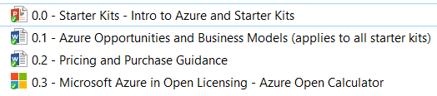
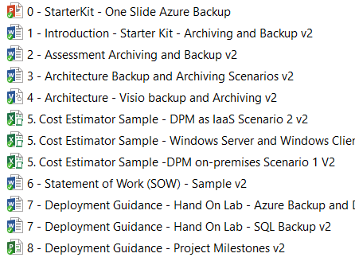
Starter Kits – Usage and Bill of Materials
A set of deliverables, packaged as an offering. Starter kits are designed to show a partner a specific scenario in Azure that could be possible for them to build and equip in the technical sales and deployment cycle. Supports you to create a profitable business and delivering state-of-the-art solutions.
Starter Kits Bill of Materials (BOM)
Common:
Enablement: Getting Ready | Starter Kit Pre-Sales Shadowing: Accelerating a Deal | Starter Kit Deployment Shadowing: Accelerating a Deployment
Get ready to offer solutions and engage in opportunities based on Starter Kits Scenarios Understand the Bill of Material and how to use it in Sales, Migration and Deployment scenarios. | Pre-Sales Stage Accelerate a deal by leveraging the Starter Kits BOM Receive 1:1 support from Microsoft experts throughout the deal lifecycle | Project/Deployment stages Accelerate a deployment by leveraging the Starter Kits BOM Receive 1:1 support from Microsoft experts throughout the deployment lifecycle
Adv Hours. 5 Hours | Adv Hours. Free | Adv Hours. Avg. 5 Hours (may vary depending on project complexity)
Unlimited participants from your Company Offering available in 1:1 bases, request 1:1 through askpts@microsoft.com
Scenario based:
Notes:
What is an Azure Starter Kit and what it included?
Starter Kit A set of deliverables, packaged as an offering. Starter kits are designed to show a partner a specific scenario in Azure that could be possible for them to build and equip in the technical sales and deployment cycle. Supports you to create a profitable business
Starter Kits – 1:1
Remote session dedicated to your company
On this modality we will provide a DEEP review of the Bill of Material (BOM) and explain how to use it in a Sales, Migration or Deployment scenario.
Starter Kits for Enablement cost 5 Hours
Starter Kits Shadowing on presales, no Cost – Use the shadowing concept to accelerate a deal.
Starter Kits Shadowing on Deployment, Advisory hours based on scenarios. Avg. 5 Hours. Use the shadowing concept to accelerate a deployment.
Request 1:1 latampts@microsoft.com

Slide 22
BOM – Deep Dive

